Slide 1

CREDIT RISK SCORING
Final Project
Project-Based Internship Id/x Partners X Rakamin Academy
by Muhammad Rizki

Slide 2
BUSINESS UNDERSTANDING
A credit score is based on credit history: number of open accounts, total levels of debt, repayment history, and other factors. Lenders use credit scores to evaluate the probability that an individual will repay loans in a timely manner
Problems statement
Based on data from 466,285 customers of a loan company, 50,968 customers have defaulted on payments
11%
Failure to Pay Debts

Slide 3
PROBLEM SOLUTION
minimize the possibility of default
determine potential target markets
determine the attributes that influence the credit score

Slide 4
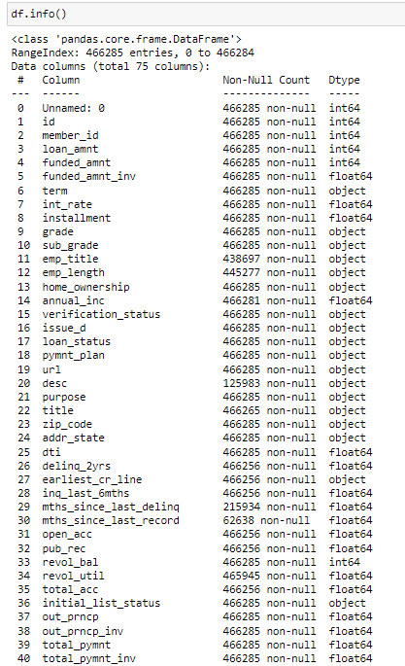
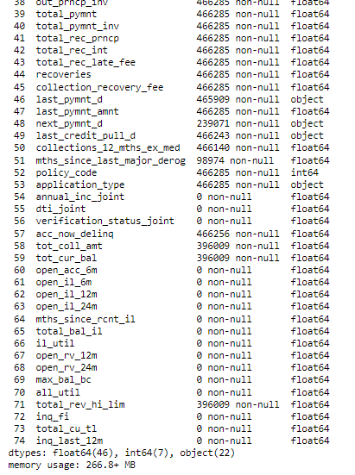
DATASET
This dataset has 466.285 rows and 74 columns. With several data types including
Float (46 columns)
Integer (6 columns)
Strings (22 columns)
This data contains customer information from loan company for the period 2007-2014
And the target variable is the
‘loan_status’ column.
There are +-460160 missing values

Slide 5
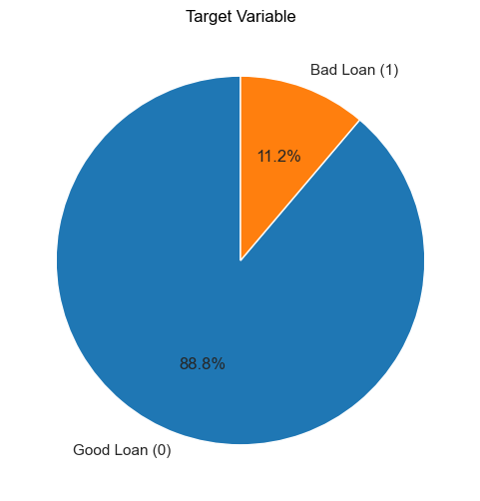
Variable Target
bad_flag
0 means good
1 means bad

Slide 6
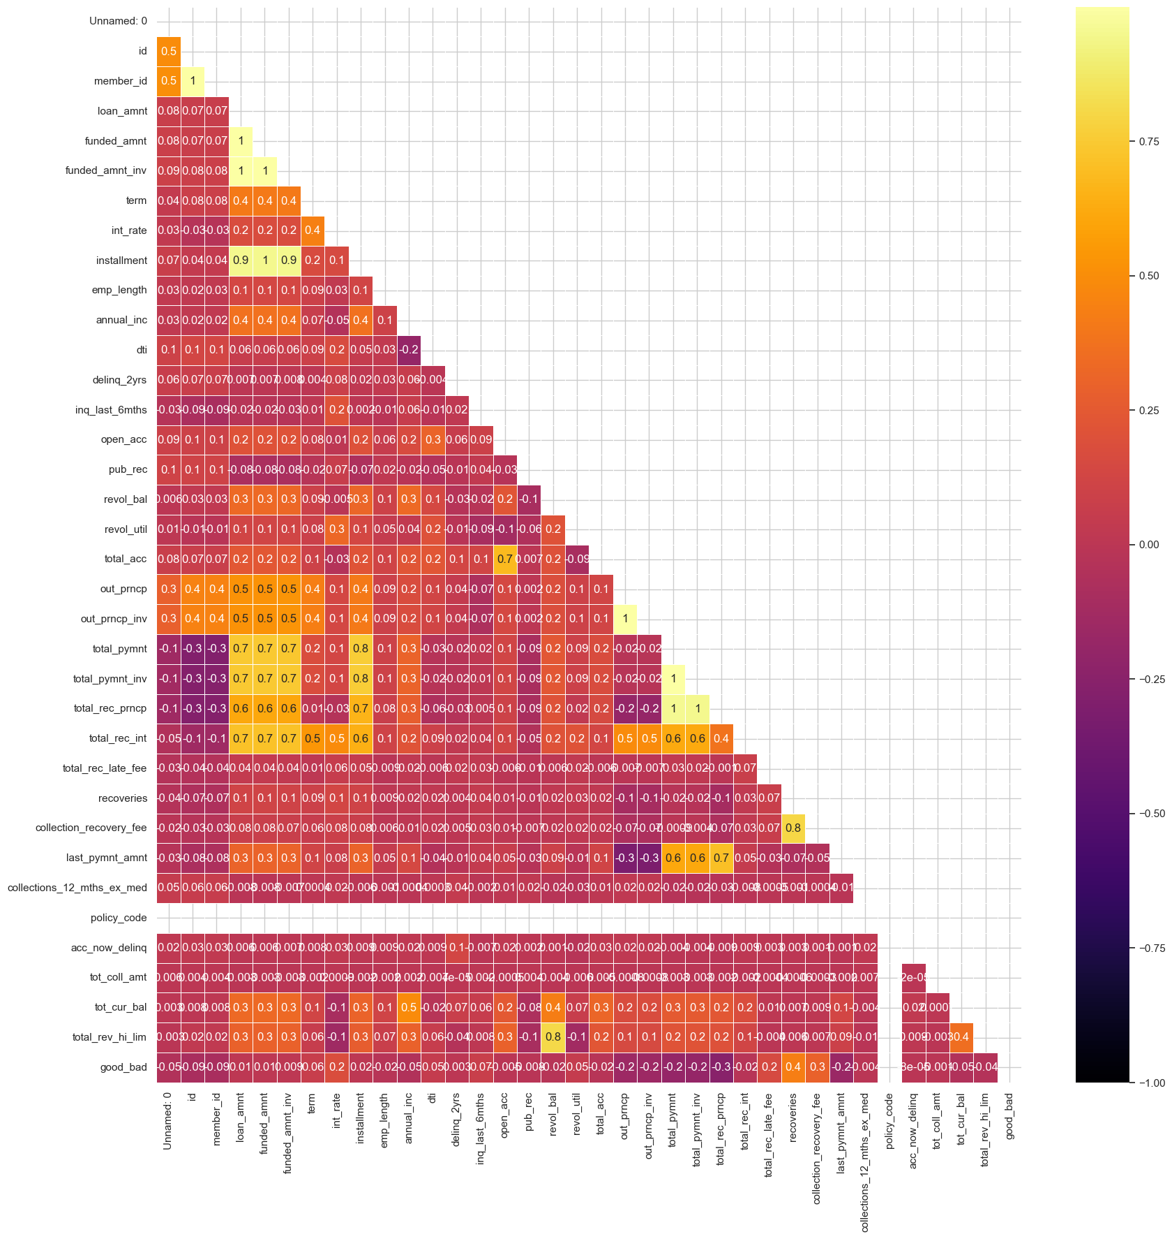
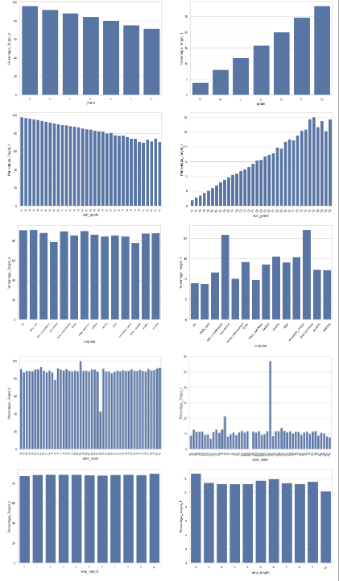
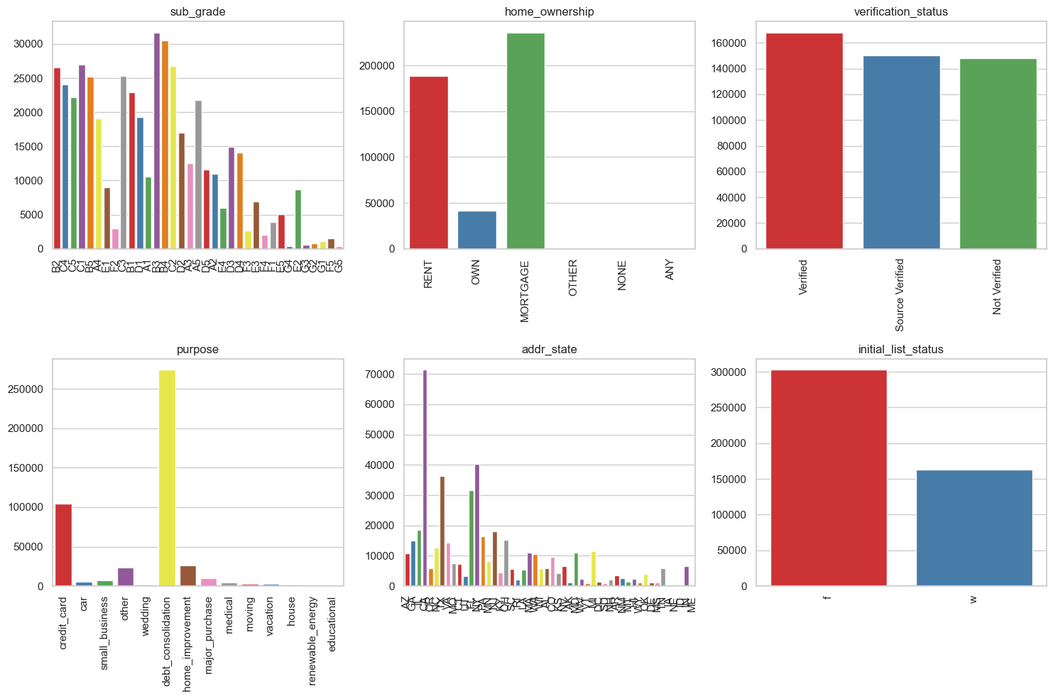
Data Preprocessing
Data Cleaning: Handle Outlier and invalid data you can organize your ideas clearly
Missing Value: delete several columns and fill in using median and mode
Feature Enggineering: create several new columns
Scaling dan Encoding: Scale numeric features and encode categorical features.
Resampling: Oversampling Minority Class to Resolve Class Imbalance

Slide 7
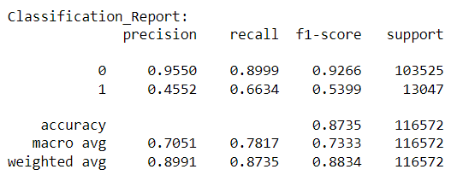
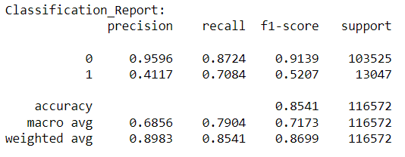
Logistic Regression
Training Model ML
Decision Tree

Slide 8
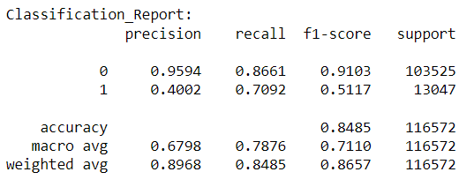
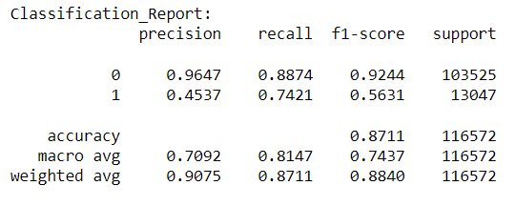
Random Forest
Training Model ML
XGBoost

Slide 9
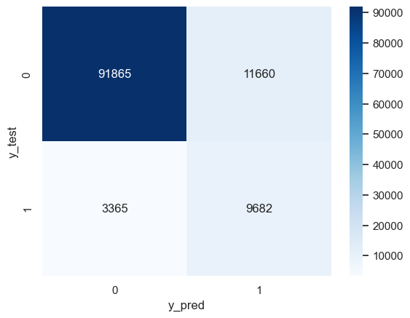
The best average accuracy result among all the models above is using XGBoost with an average accuracy value of 87%. This model has better performance in identifying high-risk loans (high precision and good recall).

Slide 10
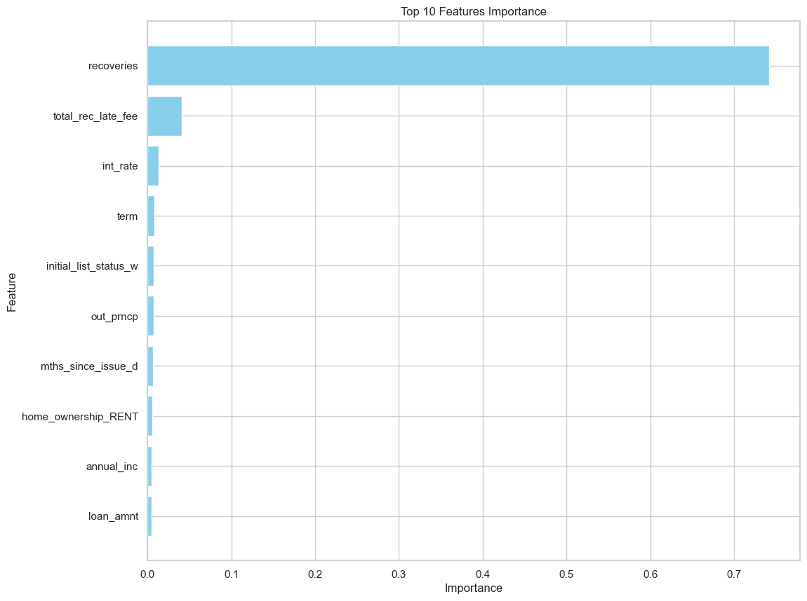
Feature Importance
The columns that significantly influence credit risk scoring are recoveries (Indicates if a payment plan has been put in place for the loan), total_rec_late_fee, andi int_rate. These columns play a pivotal role in assessing the overall creditworthiness of applicants and have a substantial impact on the scoring process

Slide 11
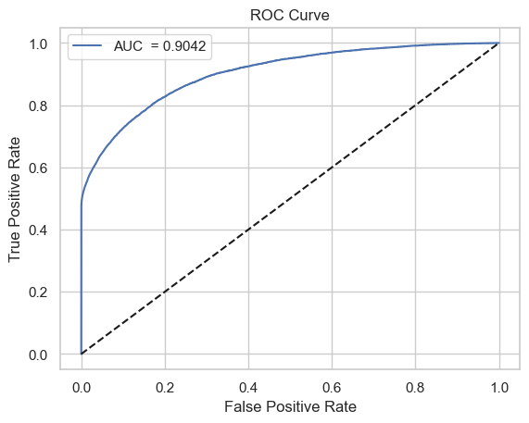
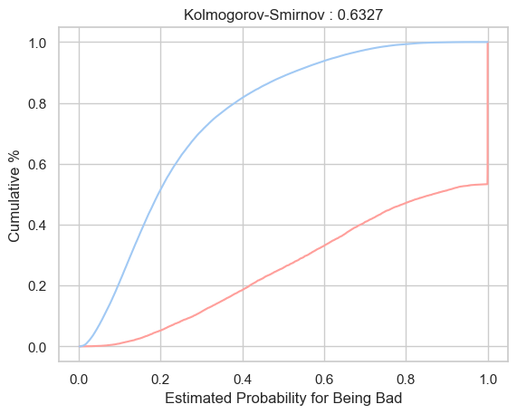
Validation
AUC (Area Under the ROC Curve)
KS (Kolmogorov-Smirnov)
In the world of credit risk modeling, generally AUC above 0.7 and KS above 0.3 are considered good performance.

Slide 12
-THANK YOU -

